Slide 1

Group AG-10
Physical Design of
RISC-V based
System-on-Chip
using OpenLane
Ajith Sai Visal
CB.EN.P2VLD25002
Arvind Narayan B
CB.EN.P2VLD25004
Department of Electronics and Communication Engineering
Amrita School of Engineering
Amrita Vishwa Vidyapeetham, Coimbatore – 641112
25VL742 — Physical Design
24 March 2026
1

Slide 2
Aim
To implement the complete physical design of a RISC-V based PicoSoC using the open-source OpenLane EDA flow targeting the SkyWater SKY130 130 nm PDK, and complete the RTL to GDS II flow
SCOPE OF WORK
01
02
03
Design
Flow
Goals
RISC-V PicoSoC (RV32IMC)
RTL Simulation
Timing closure @ 100 MHz
PicoRV32 + UART + SPI
Synthesis → Floorplan
Zero DRC violations
SRAM + Memory Decoder
CTS → Routing
LVS clean sign-off
SKY130 130 nm PDK
DRC + LVS + STA
Tapeout-quality GDS
25VL742 Physical Design | Group AG-10 | Amrita Vishwa Vidyapeetham
2

Slide 3
Abstract
Project
Complete physical design of a RISC-V based PicoSoC using open-source OpenLane targeting SkyWater SKY130 130 nm PDK
Architecture
PicoRV32 CPU (RV32IMC) + UART + SPI Flash Controller + SRAM — all on a 32-bit system bus
Flow
RTL simulation (Icarus Verilog) → Synthesis (Yosys) → Floorplan → CTS → Routing → DRC + LVS sign-off
Runtime
OpenLane completed in 1h 21m | 42,194 synthesized cells | Die area: 2.41 mm²
Timing
Timing closure at 100 MHz — WNS = 0.0 ns, TNS = 0.0 ns | DRC: 0 violations | LVS: Clean
Routing
~2.99 million µm wire length | 368,965 vias | 6 metal layers (li1, met1–met5)
Conclusion
Confirms open-source VLSI tools are capable of tapeout-quality physical design in academic settings
25VL742 Physical Design | Group AG-10 | Amrita Vishwa Vidyapeetham
3

Slide 4
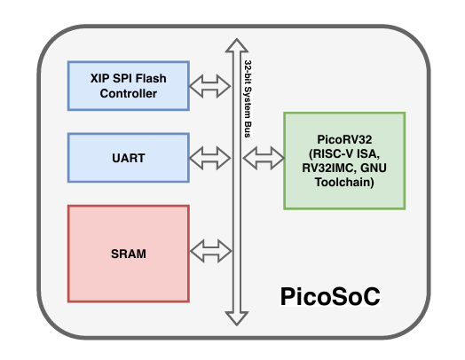
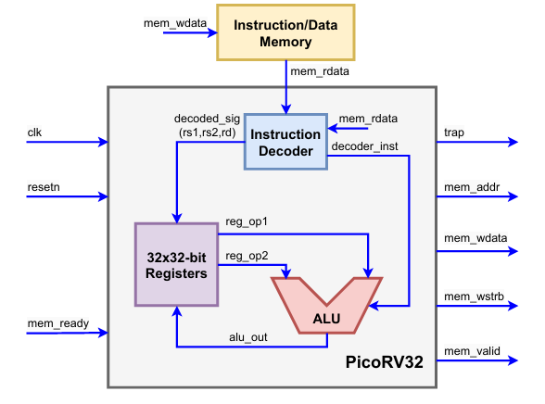
PicoSoC Architecture
PicoSoC Overall Block Diagram
PicoRV32 Simplified Block Architecture
Fig. 1: PicoSoC Block Diagram
Fig. 2: PicoRV32 Simplified Block Architecture [1]
25VL742 Physical Design | Group AG-10 | Amrita Vishwa Vidyapeetham
4

Slide 5
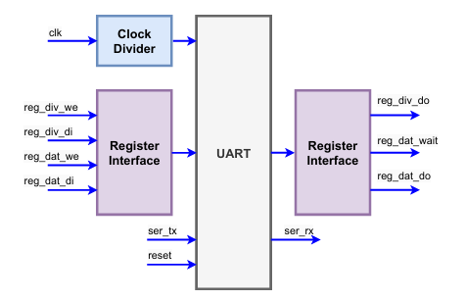
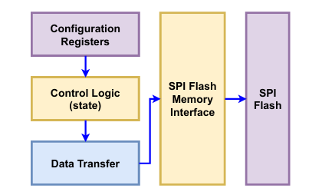
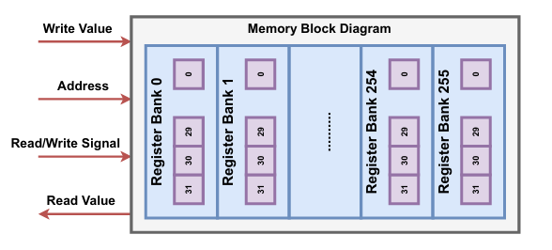
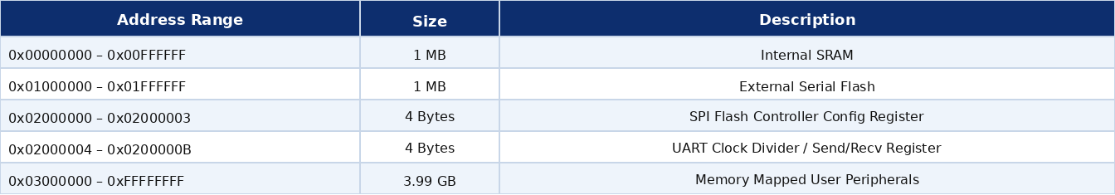
Module Block Diagrams
UART
SPI Flash Controller
Memory
Fig. 5: Memory Block Diagram
Fig. 3: UART Block Diagram
Fig. 5: Memory Block Diagram
Fig. 4: SPI Block Diagram
PICOSOC MEMORY MAP
25VL742 Physical Design | Group AG-10 | Amrita Vishwa Vidyapeetham
5

Slide 6
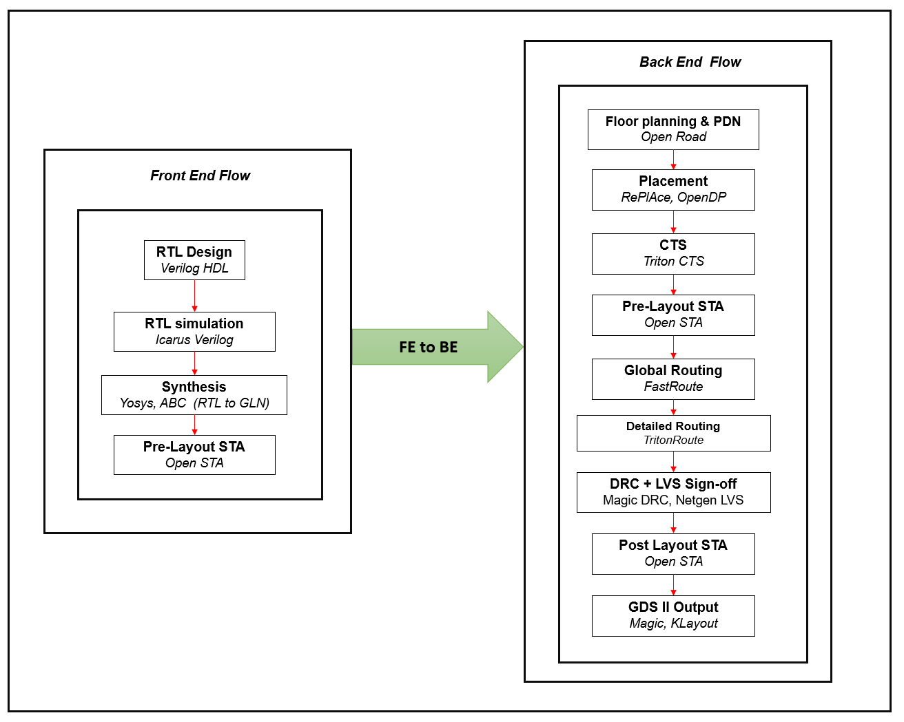
RTL to GDS II Flow
Fig. 6: RTL to GDS II Physical Design Flow using OpenLane (SKY130 PDK)
25VL742 Physical Design | Group AG-10 | Amrita Vishwa Vidyapeetham
6

Slide 7
Methodology
Front End Flow
Back End Flow
RTL Design
Floorplanning & PDN
Verilog HDL — PicoRV32, UART, SPI, SRAM, Memory Decoder
OpenROAD — macro placement, power straps, die 1547×1558 µm
RTL Simulation
Placement
Icarus Verilog — functional verify, golden waveform
RePlAce (global) + OpenDP (detailed) | antenna diodes
Synthesis
CTS
Yosys + ABC → sky130_fd_sc_hd | AREA 0 strategy
TritonCTS — balanced clock tree | skew: 0.29 ns
Pre-Layout STA
Routing & Sign-off
OpenSTA — setup/hold timing verified at 100 MHz
FastRoute + TritonRoute | Magic DRC | Netgen LVS | OpenSTA
25VL742 Physical Design | Group AG-10 | Amrita Vishwa Vidyapeetham
7

Slide 8
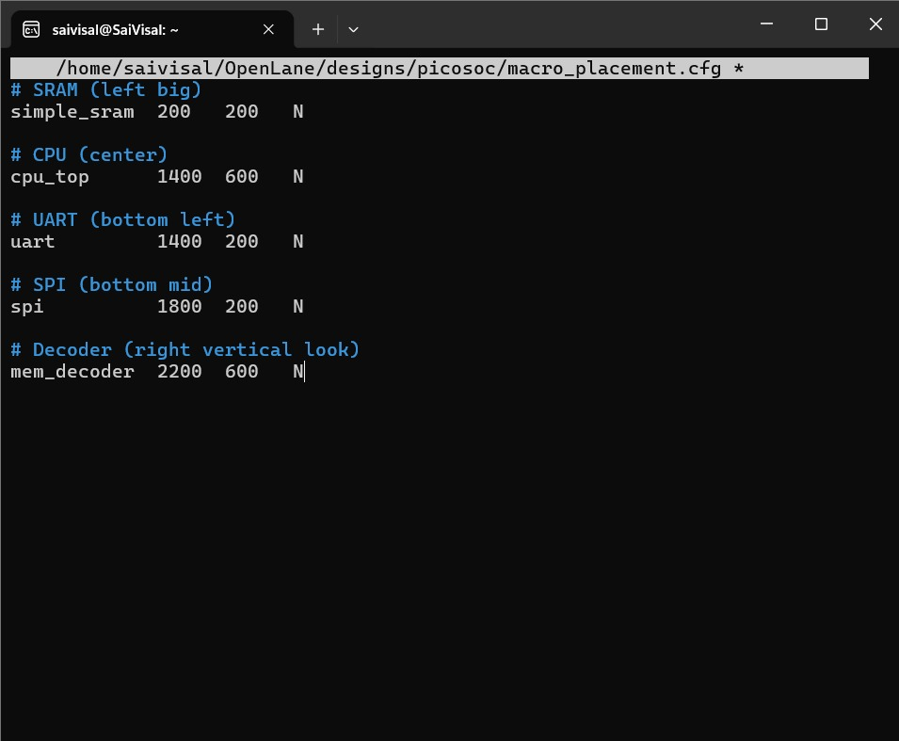

Slide 9
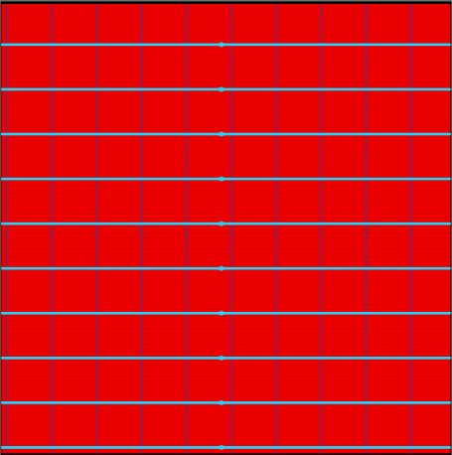
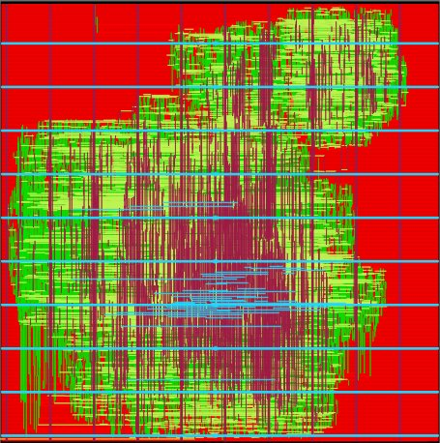
Results: Floorplanning & Placement
4.1 Floorplanning & PDN — OpenROAD
4.2 Placement & Routing — RePlAce + OpenDP
Fig. 7: Standard cell placement — (KLayout)
Fig. 8: Complete Detailed routing – Open Road Visualization
25VL742 Physical Design | Group AG-10 | Amrita Vishwa Vidyapeetham
9

Slide 10
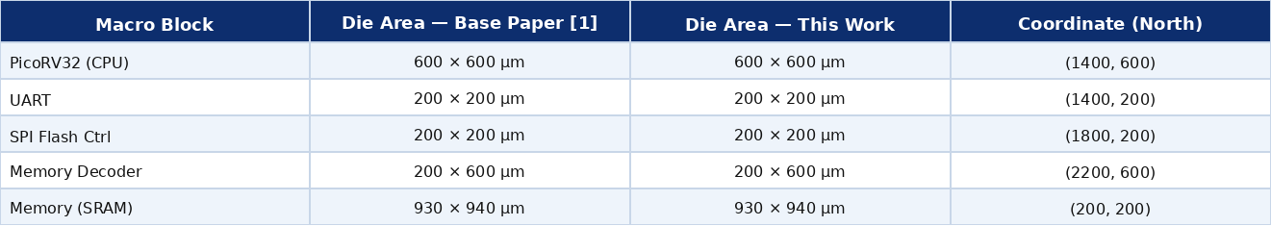
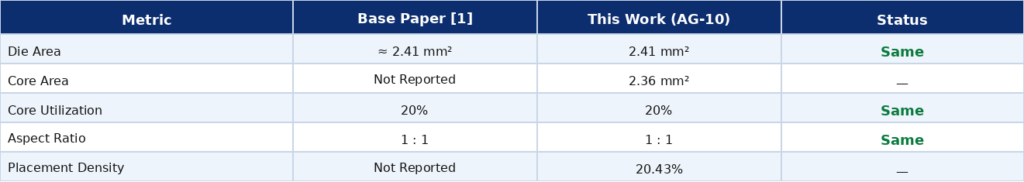
Area Comparison — Macro Die Areas
Macro-level die areas and placement coordinates — Base Paper [1] vs this implementation.
Table 1: Macro-level Die Area & Placement Coordinates — Base Paper [1] vs This Work
OVERALL CHIP AREA METRICS
Table 2: Overall Chip Area Metrics — Base Paper [1] vs This Work
25VL742 Physical Design | Group AG-10 | Amrita Vishwa Vidyapeetham
10

Slide 11
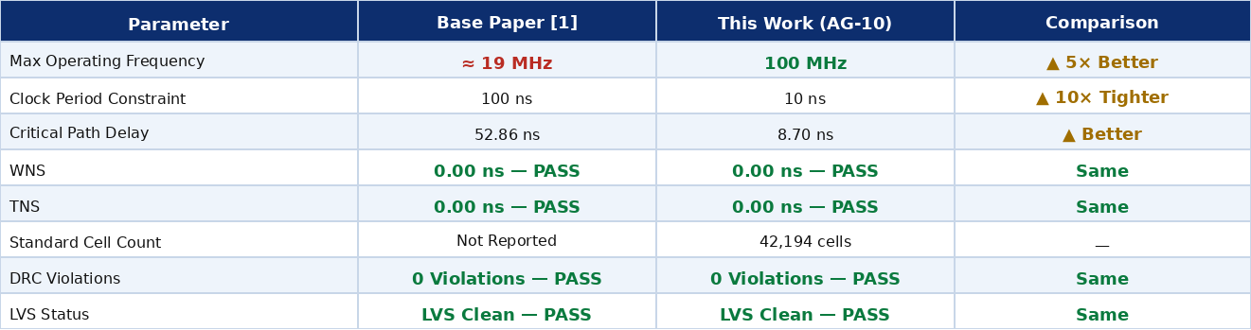
Comparison — Performance Metrics
Key performance metrics compared. Maximum operating frequency is the primary improvement over the base paper [1].
Table 3: Performance Metrics Comparison — Base Paper [1] vs This Work
Key Observation
This implementation achieves 100 MHz — 5× higher than the base paper's 19 MHz — by applying a 10 ns clock period constraint (10× tighter). All physical verification metrics (die area, DRC, LVS) are identical or better.
25VL742 Physical Design | Group AG-10 | Amrita Vishwa Vidyapeetham
11

Slide 12
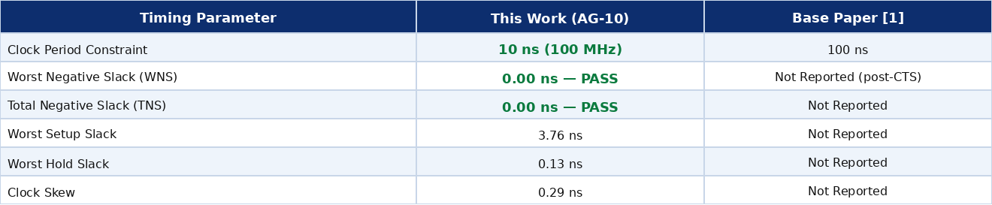
Results: Clock Tree Synthesis — Timing
Post-CTS timing results. Base paper used 100 ns constraint; this work uses 10 ns (100 MHz).
Table 4: CTS Timing Results — This Work vs Base Paper
Key Observation
This implementation targets 10 ns (100 MHz) — 10× tighter than the base paper's 100 ns constraint. TritonCTS achieved a clock skew of 0.29 ns, demonstrating excellent clock distribution for a 42,194-cell multi-macro SoC design.
25VL742 Physical Design | Group AG-10 | Amrita Vishwa Vidyapeetham
12

Slide 13
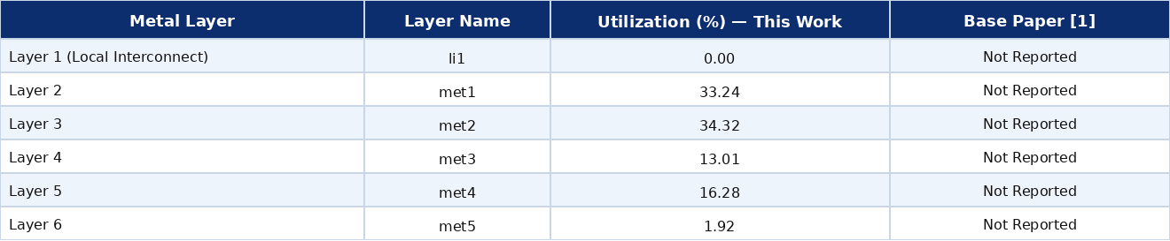
Results: Global Routing — Layer Utilization
Routing resource utilization per metal layer after FastRoute. Base paper does not report per-layer utilization.
Table 5: Metal Layer Routing Utilization — FastRoute (This Work)
Key Observation
met1 (33.24%) and met2 (34.32%) carry the highest routing load — consistent with SKY130 standard cell routing. li1 (0%) is reserved for standard cell internal connections. Total: 2,986,170 µm wire length and 368,965 vias.
25VL742 Physical Design | Group AG-10 | Amrita Vishwa Vidyapeetham
13

Slide 14
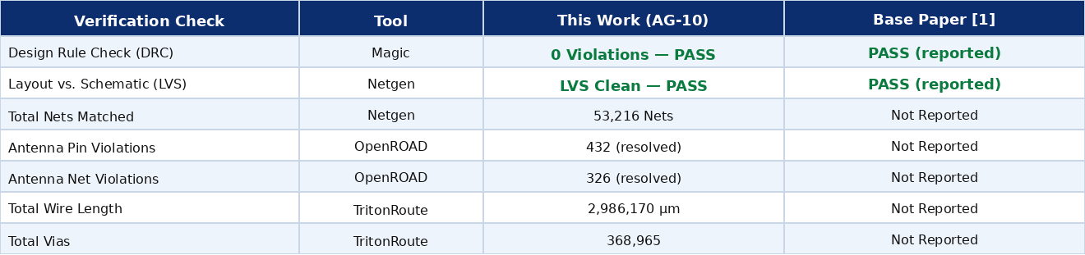
Results: DRC + LVS Physical Sign-off
Physical verification results compared with the base paper [1].
Table 6: Physical Sign-off Results — This Work vs Base Paper
Key Observation
Both this work and the base paper achieved DRC-clean and LVS-clean results. Antenna violations (432 pin, 326 net) were fully resolved via antenna diode insertion — a standard physical design practice for designs of this scale.
25VL742 Physical Design | Group AG-10 | Amrita Vishwa Vidyapeetham
14

Slide 15
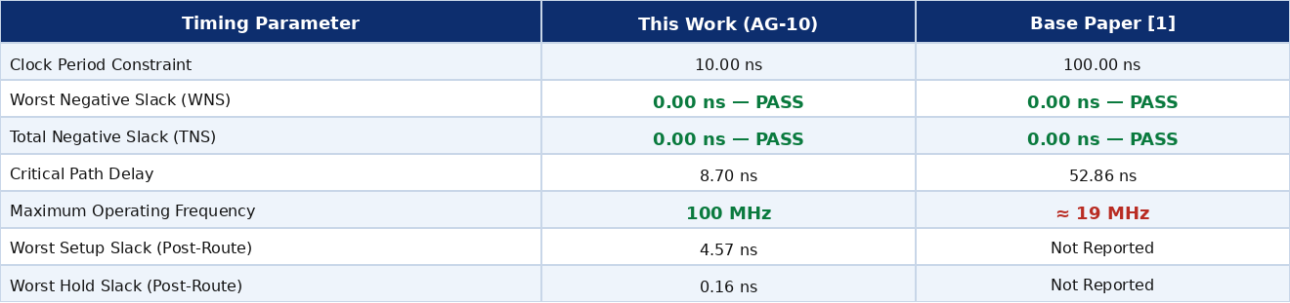
Results: Post-Layout STA — Timing
Final timing sign-off on the fully routed netlist (OpenSTA). 100 MHz is 5× better than base paper.
Table 7: Post-Layout STA Results — This Work vs Base Paper [1]
Key Observation
Maximum operating frequency of 100 MHz is 5× higher than the base paper's 19 MHz. Both designs achieve WNS = TNS = 0.0 ns, confirming full timing closure under their respective constraints.
25VL742 Physical Design | Group AG-10 | Amrita Vishwa Vidyapeetham
15

Slide 16
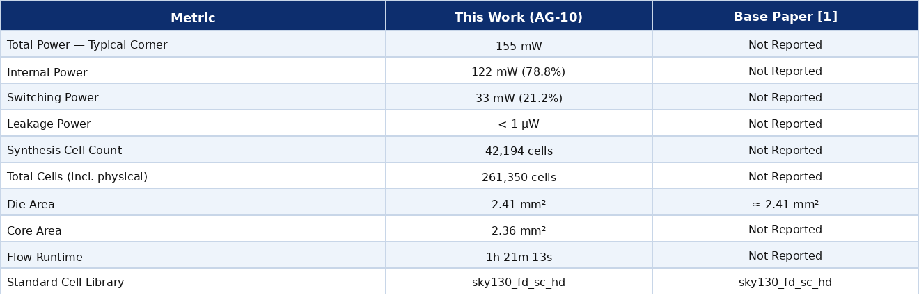
Results: Post-Layout STA — Power & Summary
Power consumption and design summary metrics from the final routed implementation.
Table 8: Power & Summary Metrics — This Work vs Base Paper [1]
25VL742 Physical Design | Group AG-10 | Amrita Vishwa Vidyapeetham
16

Slide 17
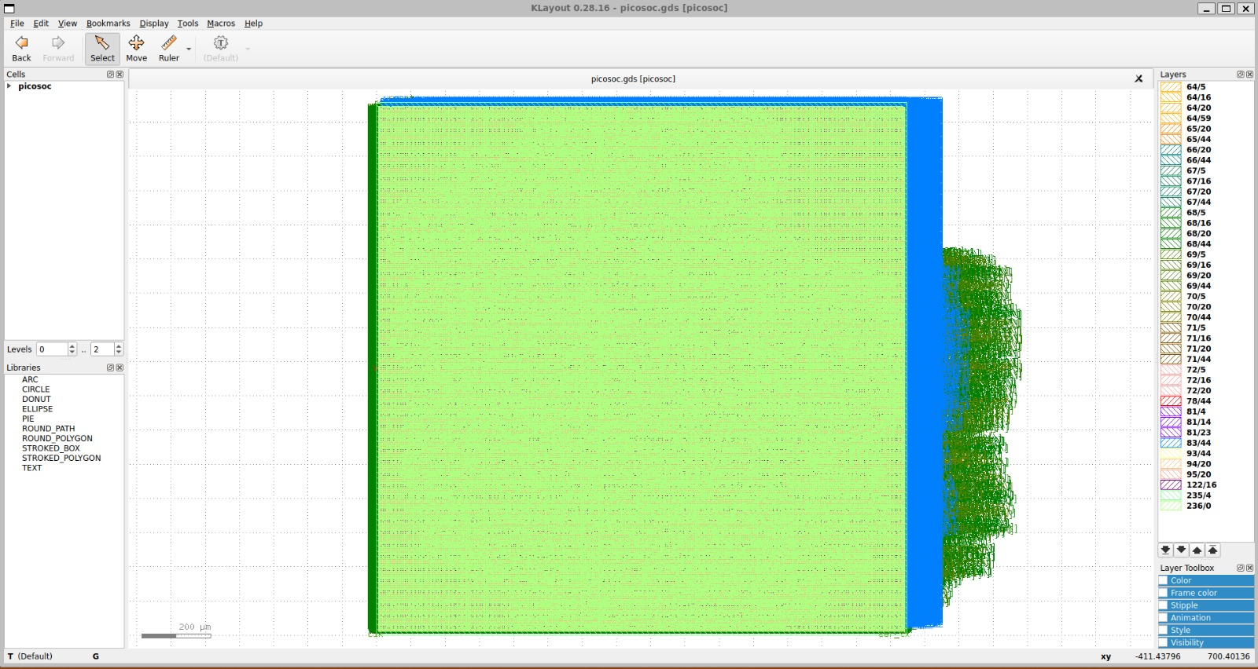

Slide 18
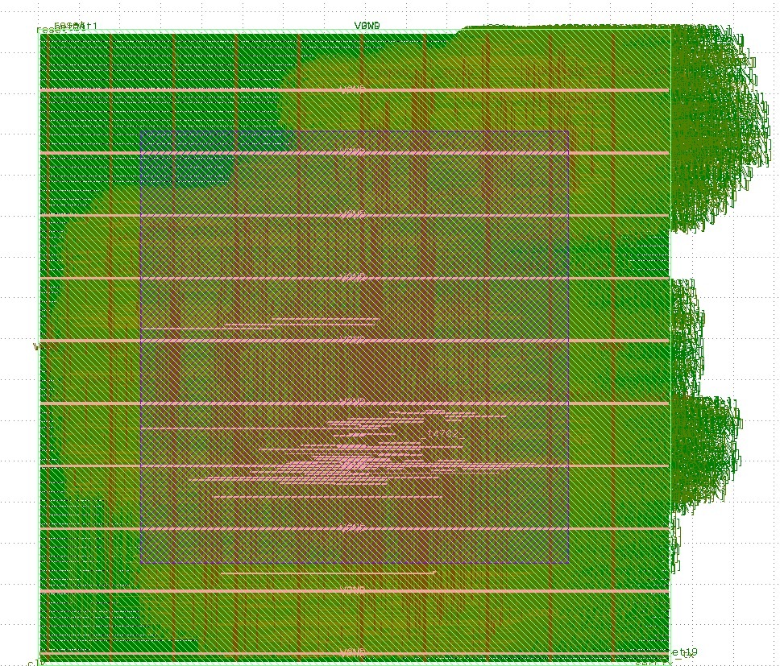
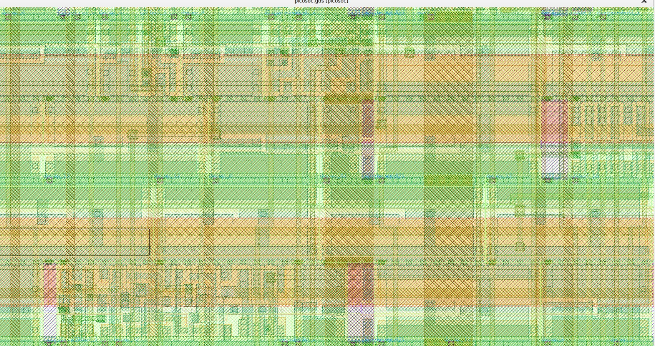
Results: GDS II Output
Full Chip Layout — KLayout 0.28.16
Zoomed-in Layout View
Fig. 10: Zoomed view — standard cells, routing & vias
▸
Streamed using Magic after DRC, LVS & antenna sign-off
▸
All 5 macros within 1546.9 × 1557.6 µm die boundary
Fig. 9: Complete PicoSoC GDS II layout (Metal Layers hidden) — KLayout
▸
Outputs: picosoc.gds · picosoc.lef · picosoc.spef
25VL742 Physical Design | Group AG-10 | Amrita Vishwa Vidyapeetham
18

Slide 19
Inference
Flow Completion
Routing
OpenLane RTL-to-GDS completed in 1h 21m — confirming open-source EDA viability for complete SoC physical design
met1 (33.24%) and met2 (34.32%) carry highest utilization — consistent with SKY130
Timing Closure
Antenna
100 MHz achieved (WNS = TNS = 0.0 ns) — 5× better than base paper's 19 MHz
432 pin and 326 net violations resolved via diode insertion — standard for this scale
Physical Verification
Power
Magic DRC: 0 violations | Netgen LVS: clean | 53,216 nets matched
155 mW at typical corner — majority in combinational logic, expected for processor-centric design
CTS Quality
Area & Placement
TritonCTS achieved 0.29 ns clock skew — excellent for a 42,194-cell multi-macro SoC
20.43% density vs 20% target — correct placer operation, sufficient routing headroom
25VL742 Physical Design | Group AG-10 | Amrita Vishwa Vidyapeetham
19

Slide 20
Reference
[1]
M. Fauzan, R. F. Yanuarsyah, M. H. Hibatullah, R. Arisaputra, I. Syafalni, N. Sutisna, T. Adiono, and M. Ikeda,
"Physical Design of RISC-V based System-on-Chip using OpenLane,"
2024 IEEE Asia Pacific Conference on Circuits and Systems (APCCAS), pp. 529–533, Nov. 2024.
DOI: 10.1109/APCCAS62602.2024.10808656
25VL742 Physical Design | Group AG-10 | Amrita Vishwa Vidyapeetham
20

Slide 21
Thank You
Physical Design of RISC-V based System-on-Chip using OpenLane
Group AG-10 | 25VL742 Physical Design | Amrita Vishwa Vidyapeetham
21

